Slide 1


Detailed Analysis and Visualization of Population Data
COMP1844
Week 10 Report

Slide 2
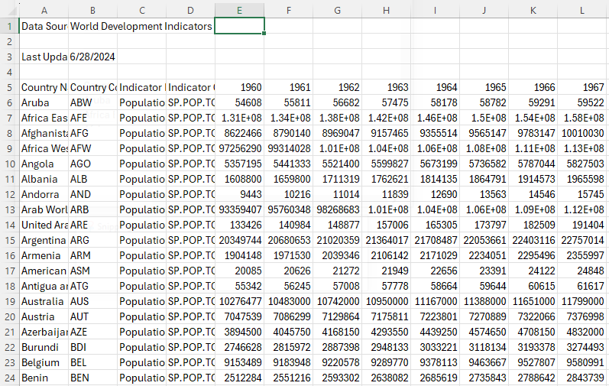
Introduction
Data analysis and visualization are indispensable in understanding large datasets
Two Python scripts are designed to analyze country-wise population data from 1960 – 2023
Illustrations of comprehensive approach to handling and visualizing large datasets

Slide 3
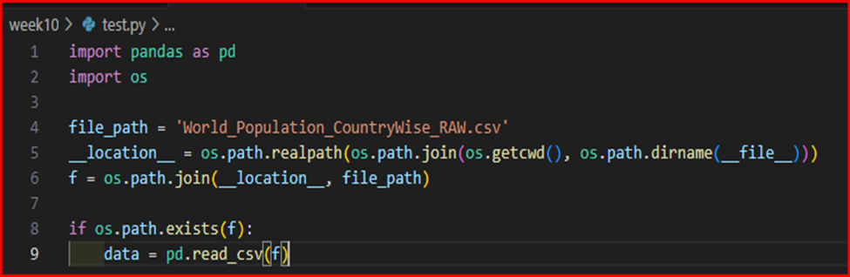
Data Loading and Preprocessing
The first steps are loading data from CSV file and preprocessing, ensuring it is suitable for analysis.
Both scripts construct file path dynamically for compatibility across environments.

Slide 4
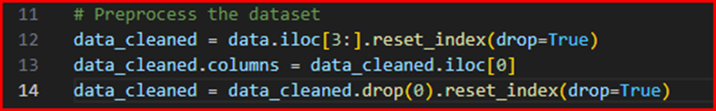
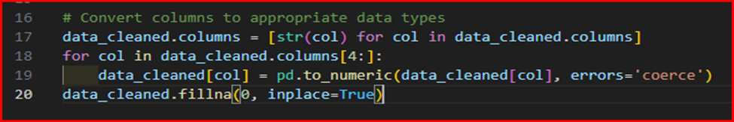
Data Loading and Preprocessing
Unnecessary metadata is removed, and the dataset is set up for further manipulation.
Population data columns are converted to numeric values, while non-numeric entries are coerced to NaN and filled with 0 to handle missing data.
The data is clean and consistent for accurate analysis and visualization.

Slide 5
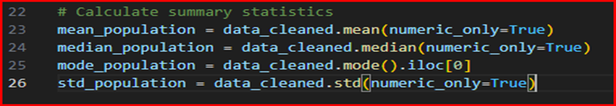
Summary Statistics Calculation
Summary statistics are calculated in both scripts.
Mean: Provides average population per year and a central value for data point distribution.
Median: Middle value of data, less affected by outliers and skewed data than mean.
Mode: The most frequently occurring population value each year. Provide insights into common population sizes.
Standard Deviation: Measures dispersion of data from the mean. The higher, the greater variability in data.

Slide 6
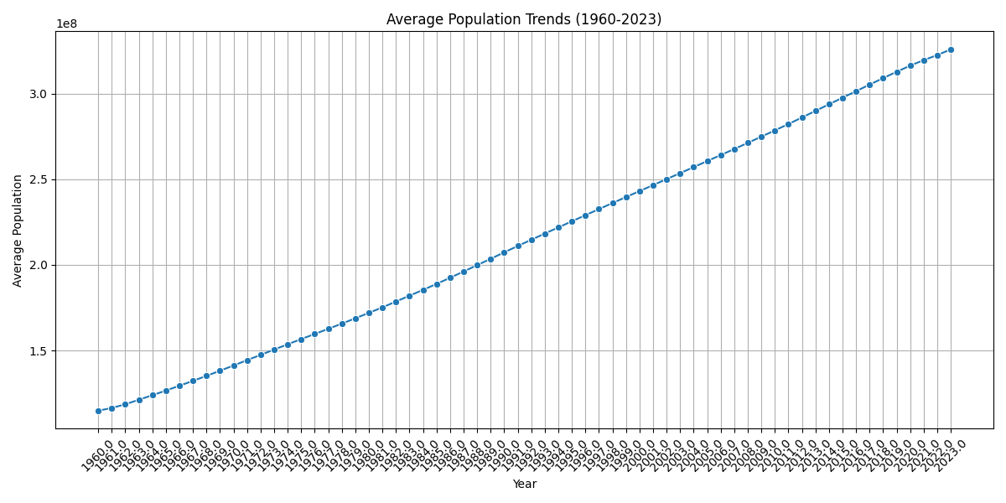
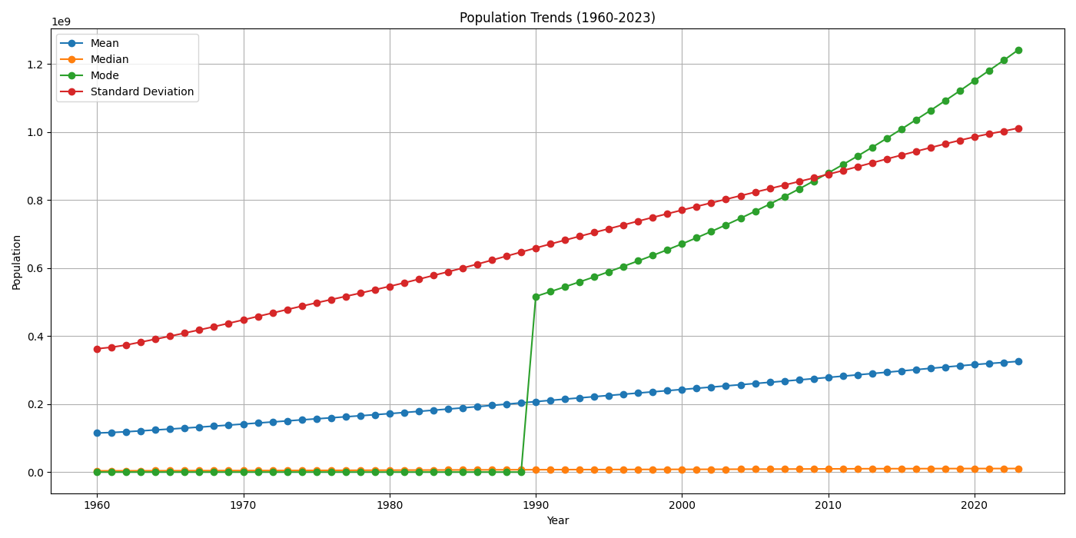
Visualization
A powerful tool for data interpretation and communication
Matplotlib and seaborn are utilized to create plots illustrating population trends and distributions.

Slide 7
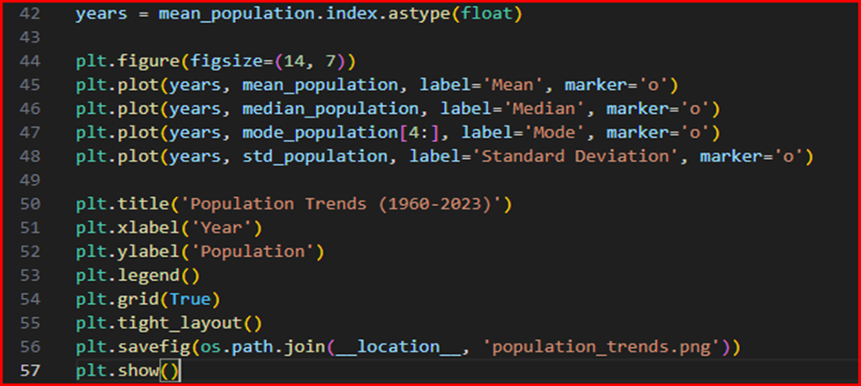
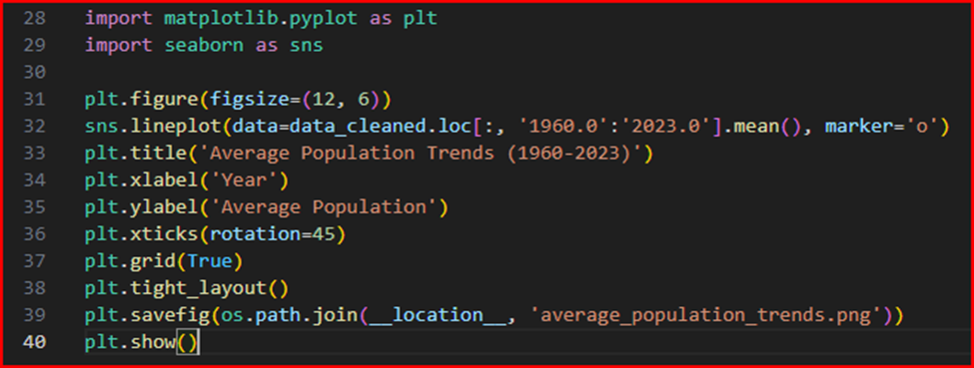
Visualization: Population Trends Over the Years
Group_work.py
Group_work_2.py
Shows average population trends (1960-2023)
Highlights how the average population changed over time
Expands on group_work.py by plotting all statistic, not only the mean.
Multi-faced view of population trend

Slide 8
Population Trends Over the Years
Group_work.py
Group_work_2.py

Slide 9
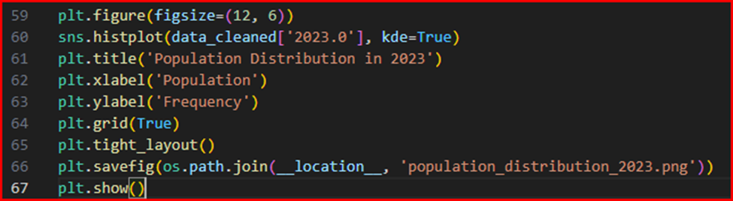
Visualization: Population Distribution (2023)
Both scripts generate a histogram, showing the population sizes distribution for the year 2023.

Slide 10
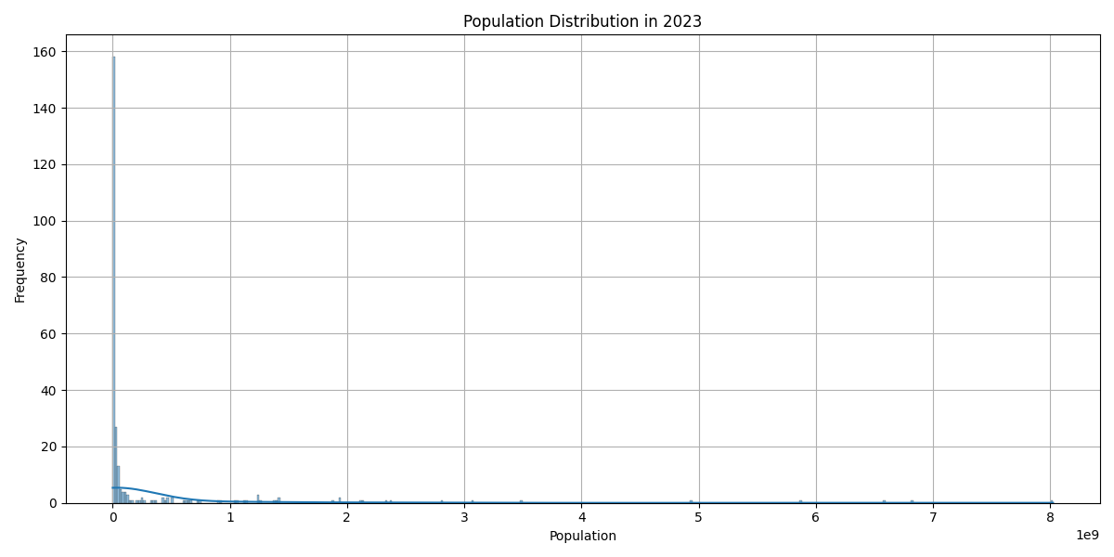
Population Distribution (2023)
The histogram provides insights into the spread and concentration of population sizes across countries

Slide 11
Saving the Dataset
An additional step in group_work_2.py is included to save preprocessed dataset to a new CSV file for future use without repeated preprocessing.

Slide 12
Conclusion
Effectively demonstrate the process of data analysis and visualization
Highlight the importance of data cleaning and preprocessing
Provide valuable insights into trends and distributions
Make complex data more accessible
Both Python scripts also serves as the foundations for advanced data exploration and analysis, and the techniques demonstrated are essential for demographic data work.

Slide 13
That’s all, folks!
Thanks for watching.

